Slide 1
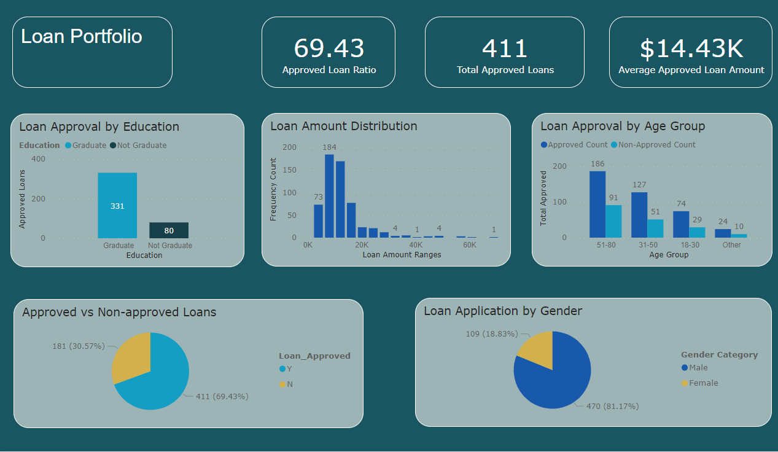

Slide 2
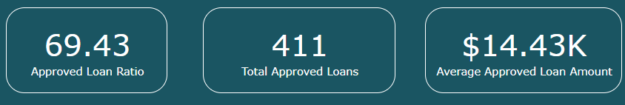
Approved Loans Ratio: % of approved loans from total applications. Calculated as approved loans / total applications.
The loan approval ratio for members is around 69.43%, indicating that a significant portion of members have been approved for loans. This ratio could be further investigated to understand factors influencing approvals and to fine-tune lending strategies.
Avg. Approved Loans: Average loan amount for approved loans. Calculated as total approved loan amount / number of approved loans.
These metrics are essential for Sales to gauge approval effectiveness, total approvals, and average loan size.

Slide 3
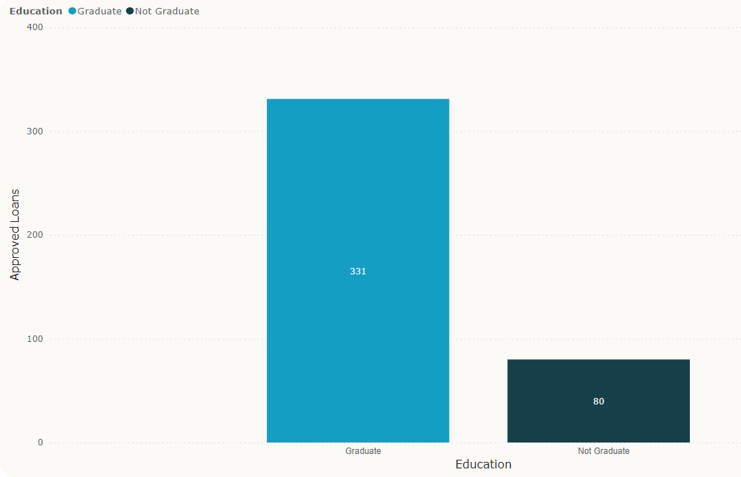
Insight 1: Loan Approval by Education Level

Slide 4
Loan Approval by Education Level
Chart: Stacked Bar Chart
Education's Influence on Loan Approvals: A Notable Trend
Analyzing loan approval rates by education level reveals an interesting trend within the membership. The data suggests that individuals with a graduate education tend to have a higher loan approval rate compared to those without a graduate degree. This disparity could stem from factors such as higher earning potential and stronger financial stability among those with advanced education. Gulf Winds Credit Union could capitalize on this insight by tailoring financial products and services that specifically cater to the unique needs and preferences of members with different education backgrounds. This could involve offering special loan packages or educational resources that address the financial concerns of both graduates and non-graduates.
Educational Attainment and Financial Responsibility: A Connection
A deeper exploration into loan approvals by education level might uncover a correlation between educational attainment and financial responsibility. Members with higher education levels could exhibit better financial habits and decision-making skills, influencing their eligibility for loans. This insight could prompt Gulf Winds to design financial wellness programs that emphasize responsible financial behavior, budgeting strategies, and effective debt management. By nurturing financial literacy, the credit union not only enhances loan approval rates for its members but also contributes to their overall financial well-being.

Slide 5
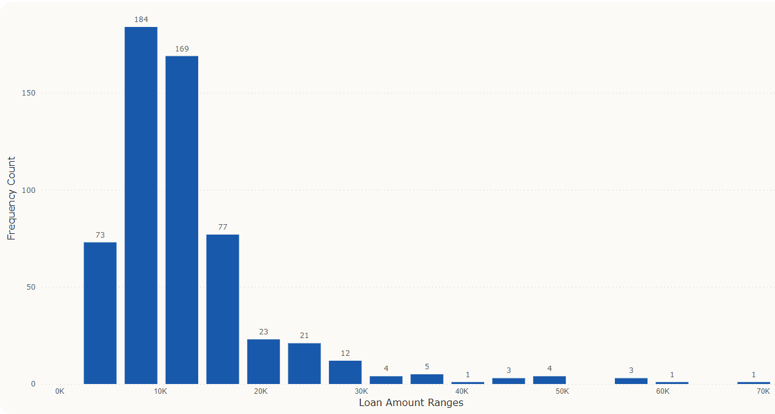
Insight 2: Loan Amount Distribution

Slide 6
Loan Amount Distribution
Chart: Histogram
Diverse Loan Amount Distribution: Catering to Financial Needs
The distribution of loan amounts within the membership showcases a diverse range of financial requirements. This heterogeneity signifies that Gulf Winds Credit Union effectively serves members with a spectrum of borrowing needs. Some members seek smaller loan amounts, which might reflect short-term goals or immediate financial needs. Others opt for larger loan amounts, indicating substantial investments such as education, homeownership, or business ventures. This variance underscores the credit union's adaptability to members' financial aspirations, positioning it as a versatile financial partner.
Tailored Financial Solutions: Addressing Individual Goals
The varied loan amount distribution prompts Gulf Winds to develop tailored financial solutions. Understanding members' preferences and financial goals enables the credit union to design loan products that cater to specific needs. For members seeking smaller loans, flexible repayment terms and lower interest rates might be emphasized to accommodate their circumstances. Conversely, members applying for larger loans may benefit from personalized consultation and comprehensive financial planning to ensure successful repayment. By recognizing the unique financial journeys of its members, Gulf Winds can provide targeted support and foster stronger member relationships.

Slide 7
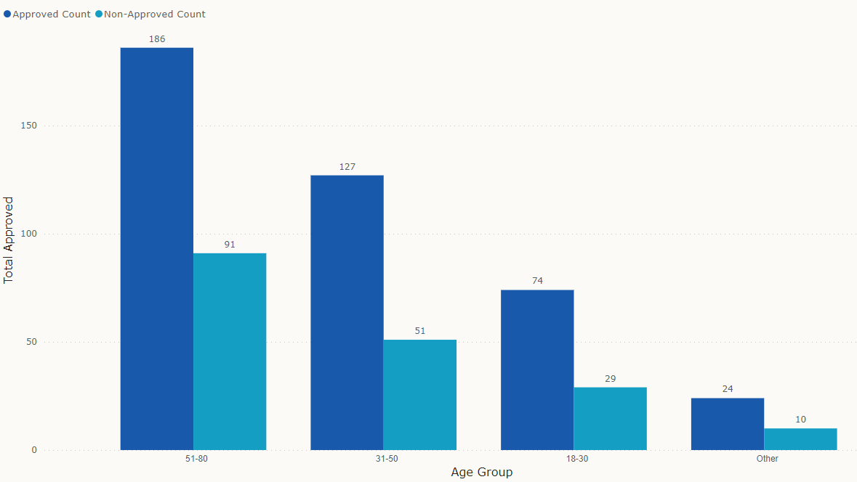
Insight 2: Loan Approval by Age Group

Slide 8
Loan Approval by Age Group
This analysis sheds light on how age influences loan eligibility, repayment capacity, and financial aspirations.
Younger members (18-30) show varying loan approval rates. This segment might consist of students, recent graduates, and early-career professionals seeking loans for education, starting a business, or making significant purchases. Understanding their specific needs can guide the credit union's efforts to support young borrowers' financial growth.
Members in their prime earning years (31-50) tend to have higher approval rates. This aligns with their established financial stability, steady income sources, and potential assets. Loans for homeownership, education, and family expenses are common in this stage.
The older age group (51 and above) may require loans for retirement planning, health care, and financial support for family members. Approvals in this category can reflect the credit union's role in aiding members during life transitions.
Membership Composition: The distribution of loan approvals across age groups highlights the composition of Gulf Winds' membership. Understanding the predominant age groups can aid in tailoring marketing efforts and services to effectively engage members at different life stages.
Member Lifecycle: Analyzing loan approvals by age group maps out members' financial lifecycles. Gulf Winds can tailor its products and services to match members' evolving needs, such as providing financial education for young adults and retirement planning for older members.

Slide 9
Recommendations:
Based on the analysis of approved and non-approved loans, the following strategies can help to enhance loan approval rates:
1. Targeted Marketing Campaigns: To capitalize on the insights from the data analysis, the Sales team should consider launching targeted marketing campaigns. For example, they can create campaigns that highlight the benefits of joint loan applications for married individuals, showcasing how combined incomes positively impact loan eligibility and approval rates. Additionally, the team can design educational content that emphasizes the correlation between higher education levels and increased chances of loan approval. By tailoring messages to specific demographics, such campaigns can resonate more effectively with different segments of the membership, ultimately driving higher engagement and loan application rates.
2. Customized Loan Products: The wide spectrum of loan amounts sought by members provides a prime opportunity for the Sales team to introduce customized loan products. By segmenting members based on their loan amount preferences, the team can create offerings that cater to various financial requirements. This might include introducing micro-loans for those seeking smaller amounts, while also developing jumbo loan options for members with more substantial financial needs. Offering a diversified portfolio of loan products ensures that Gulf Winds Credit Union can cater to a broader range of members, fostering stronger relationships and increasing the likelihood of successful loan applications.
3. Financial Wellness Workshops: Considering the variance in credit scores and loan approvals among different age groups, the Sales team could implement financial wellness workshops. These workshops could focus on enhancing financial literacy and educating members about responsible borrowing and credit management. By empowering members with the knowledge and tools to improve their credit scores and financial health, the Credit Union can positively influence loan approval rates. Moreover, these workshops could be specifically targeted towards age groups that exhibit lower approval rates, tailoring the content to address their unique financial challenges. This proactive approach not only supports members in their financial journey but also positions Gulf Winds as a trusted partner invested in their financial well-being.

Slide 10
**1. Targeted Marketing Campaigns: Leveraging Data Insights**
Based on the insights gathered from the data analysis, the Sales team should consider launching targeted marketing campaigns. These campaigns can be designed to specifically address the needs and preferences of different segments within the membership. For instance, given the observation that married applicants tend to have higher coapplicant incomes, the Sales team could develop marketing materials highlighting joint loan applications for married couples, emphasizing the potential benefits of dual incomes for loan eligibility. Additionally, creating educational content about the positive impact of higher education on loan approvals could resonate with members and encourage them to pursue further education to improve their financial prospects.
**2. Customized Loan Products: Addressing Diverse Financial Needs**
The wide variation in loan amounts sought by members presents an opportunity for the Sales team to develop customized loan products. By offering flexible loan options with different terms, interest rates, and repayment structures, the Sales team can cater to the unique financial requirements of individual members. For instance, the team could introduce micro-loans for smaller financial needs and jumbo loans for substantial investments. By showcasing a versatile range of loan products, Gulf Winds Credit Union positions itself as a responsive financial partner that truly understands and accommodates the diverse needs of its members.
**3. Financial Wellness Workshops: Empowering Members**
Given the apparent connection between education level and loan approvals, the Sales team could collaborate with Gulf Winds Credit Union's financial education department to organize financial wellness workshops. These workshops could be targeted towards both graduates and non-graduates, offering insights on managing finances, building credit, and making informed borrowing decisions. By helping members improve their financial literacy and understanding of creditworthiness, the Sales team contributes to a stronger foundation for loan applications. These workshops not only empower members to make better financial choices but also position Gulf Winds as a trusted financial institution invested in their members' financial success.
**4. Streamlined Application Process: Enhancing Member Experience**
One additional opportunity for the Sales team is to focus on streamlining the loan application process. Simplifying the application process and making it more user-friendly can encourage more members to apply for loans. This could involve implementing an online application portal, offering pre-approval options, and providing clear guidance on required documentation. By enhancing the overall loan application experience, Gulf Winds Credit Union can attract more applicants and provide a seamless journey from application to approval.
**5. Personalized Loan Consultations: Building Member Relationships**
The Sales team could also introduce personalized loan consultation services. This involves assigning dedicated loan officers to guide members through the application process, understand their financial goals, and recommend the most suitable loan options. These consultations can foster stronger member relationships, build trust, and ensure that members feel supported and valued throughout their borrowing journey. A personalized approach demonstrates Gulf Winds' commitment to understanding each member's unique financial situation and providing tailored solutions.
**6. Collaborative Partnerships: Exploring Joint Ventures**
Exploring partnerships with local educational institutions, employers, and community organizations can offer valuable benefits for both the Sales team and potential borrowers. Collaborating with educational institutions to provide financial literacy workshops or exclusive loan programs for students and alumni can create a win-win scenario. Similarly, forming partnerships with employers to offer special loan packages to their employees can expand Gulf Winds' reach and provide added value to members. By establishing such partnerships, the Sales team can tap into new customer segments and strengthen the credit union's presence within the community.

Slide 11
Additional recommendations
Recommendations for Gulf Winds to make the most of their member data:
Personalized Loan Offers: Utilize member data to tailor loan offers based on individual financial behaviors and preferences. This targeted approach can lead to higher approval rates and increased member satisfaction.
Risk Assessment Enhancement: Integrate external data sources to refine risk assessment models, ensuring more accurate lending decisions. This can minimize defaults and optimize the credit evaluation process.
Cross-Selling Strategies: Identify members with successful loan histories and present them with opportunities for cross-selling other financial products like savings accounts or credit cards. This can drive member engagement and expand revenue streams.
Predictive Analytics for Loan Defaults: Develop predictive models to identify potential loan default risks based on historical data and borrower behaviors. Early intervention strategies can be devised to mitigate default risks.
Fraud Detection and Prevention: Utilize data analytics to detect unusual patterns or anomalies in loan applications, helping to prevent fraudulent activities and enhance security measures.
Continuous Learning and Training: Use data insights to facilitate ongoing training for loan officers, enabling them to stay updated on evolving member preferences, lending regulations, and best practices.

Slide 12
Tools used for this projects
Python – Data exploration, cleaning and analysis
Excel – Data cleaning and manipulation
SQL - Helped me better understand the data
PowerBi - Visualization
PowerPoint – Presentation
PowerBi Dashboard:
https://app.powerbi.com/links/g0f8qDPbWb?ctid=5995a36e-76d3-4000-a572-f43ce77f6ce2&pbi_source=linkShare
Note: Python Code attached in the email

